Slide 1
Containerisation
Joni Collinge

Slide 2
Roadmap
Microservices Architecture
Containerisation
Orchestration
Azure Services

Slide 3
Monolith
Client
Front End
Business Logic
Data

Slide 4
Monolith
Client
Front End
Business Logic
Data

Slide 5
Monolith
Bug Fix
V2
Client
Front End
Business Logic
Data

Slide 6
Monolith
Bug Fix
V2
Client
Front End
Business Logic
Data

Slide 7
Microservices
Driver Manager
Data
API
Notifications
Notifications
Client
Driver Web UI
API
Data
Billing

Slide 8
Microservices
Driver Manager
Data
API
API
Notifications
Notifications
Client
Driver Web UI
API
Data
Billing

Slide 9
Microservices
Driver Manager
Data
API
API
Notifications
Notifications
Client
Driver Web UI
API
v2
Data
Billing

Slide 10
Microservices
Driver Manager
Data
API
API
Notifications
X
Notifications
Client
Driver Web UI
API
v2
Data
Billing

Slide 11
Infrastructure
Monolith
Microservices

Slide 12
Dependencies
PHP
WebSockets
Apache
Node.js
Ubuntu
Monolith
Microservices

Slide 13
Isolating dependencies
Application
WebSockets 3.1.2
Node.js 1.0.0
Ubuntu 14.04
Microservices

Slide 14
Containerisation
Application
WebSockets 3.1.2
Container
Node.js 1.0.0
Ubuntu 14.04
Linux Kernel
Host
Microservices

Slide 15



Containerisation
Application
Application 2
WebSockets 3.1.2
Java
Container
Node.js 1.0.0
Spring
Ubuntu 14.04
CentOS
Linux Kernel
Host

Slide 16


Slide 17
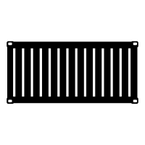
Docker ecosystem
Container Image
5001
Application
Dockerfile
WebSockets 3.1.2
Docker Engine
Node.js 1.0.0
YML
Ubuntu 14.04
Build
Docker Client

Slide 18
Docker ecosystem
Container Image
5001
Application
Should be immutable
Dockerfile
WebSockets 3.1.2
Docker Engine
Docker Hub
Node.js 1.0.0
YML
Ubuntu 14.04
Push
Docker Client

Slide 19
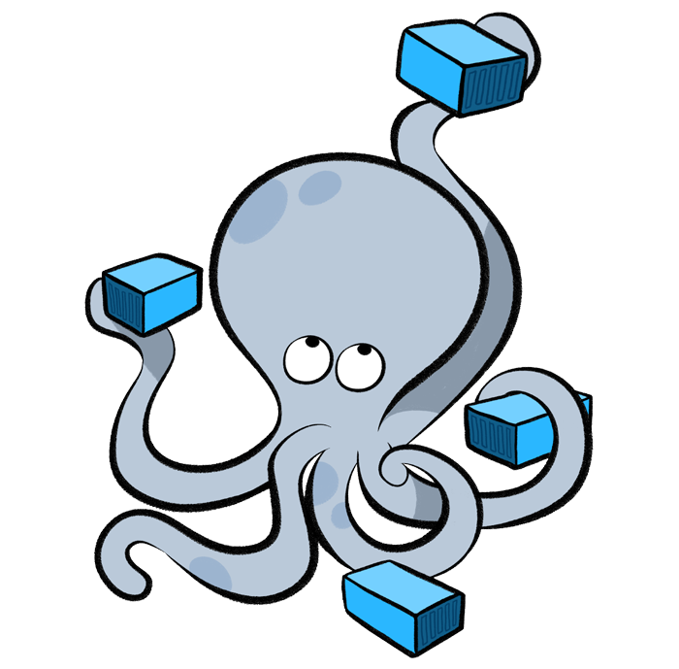
Docker Compose
Container Image 1
Docker-Compose
Container Image 2
YML
Requirements
Container Image 3
TXT

Slide 20
Docker on Windows
Application
ASP.NET Core 1.0
Container
.NET Framework 4.6
Windows Server 2016
Windows NT Kernel
Host
Microservices

Slide 21
Docker on HyperV
Application
ASP.NET Core 1.0
Container
.NET Framework 4.6
Windows Server 2016
HYPER V
Windows NT Kernel
Host
Microservices

Slide 22
Docker on Unikernel
Application
WebSockets 3.1.2
Smaller attack surface
Tiny memory footprint
No disk?!
Container
Node.js 1.0.0
Ubuntu 14.04
Unikernel
Specialised Kernel
*Not for production environments

Slide 23
Microservices

Slide 24
Service orchestration

Slide 25
Clustering

Slide 26
Scheduling

Slide 27
Leader Election

Slide 28
Discovery

Slide 29
Health + Failure

Slide 30
Scaling

Slide 31
Azure Container Service
Marathon
Docker Swarm
Apache Mesos
Docker

Slide 32
Service Fabric

Slide 33




Azure
Private
Other
Clouds
Service Fabric
Next generation scale out microservices platform

Slide 34
Azure Service Fabric Explorer
PEEK
Notes:
Service Fabric Explorer open:
http://localhost:19080/Explorer/
Cluster monitor webpage open:
http://localhost:8081/Cluster

Slide 35
Azure
Private
Other
Clouds

Slide 36


Programming Model
Guest Executables
Reliable Services
Reliable Actors
.EXE
Guest Containers
Native Containers

Slide 37
Azure Compute Continuum
IaaS
PaaS
VMs + VM Scale Sets
VM Extensions
Azure Container Service
Service Fabric
App Service
Functions
Control
Speed

Slide 38
Recap
Microservices Architecture
Containerisation
Orchestration
Azure Services

Slide 39



Call to action
Introduction to Microservices
https://www.nginx.com/blog/introduction-to-microservices/
Introduction to Service Fabric
https://azure.microsoft.com/en-gb/documentation/learning-paths/service-fabric/
Building Microservices: Designing Fine Grained Systems
Sam Newman
Joni Collinge
@dotjson

